Slide 1
Magnetic Shape Memory Alloy Composite Research
Mikela Petersen
NASA Space Grant Consortium, University of Arizona
22 April 2022 – 23 April 2022

Slide 2
Project Objective
Develop a magnetically activated composite (MAC) consisting of:
Ni-Mn-Ga Magnetic Shape Memory Alloy (MSMA)
Polymer
Iron particles
The MAC will be used to make highly compliant
Actuators
Sensors
Dampers
for nano and micro precision applications.
Notes:
the MAC should preserve the MSMA’s operating frequencies while improving the compliance of the material

Slide 3
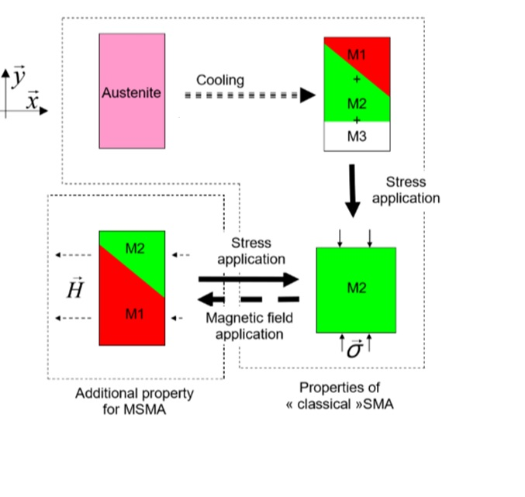
Magnetic Shape Memory Alloys (MSMA)
Specifically used the Ni-Mn-Ga alloy
At room temperature, the MSMA is in the Martensite phase
Exhibits recoverable compression and expansion strains of up to 6%
Actuation frequencies of up to 1kHz
Actuates when exposed to:
Magnetic field of a minimum of 0.5T, or
Mechanical stress of 2-3MPa
Gauthier, et.al, 2006
Notes:
Gauthier, et.al, 2006

Slide 4
Approach
A silicon polymer matrix
Iron Particles
44μm to 149μm diameter
10% to 80% particle volume fraction
and
MSMA Rod
3 mm by 3mm by 20mm
or
MSMA Particles
30% volume fraction

Slide 5
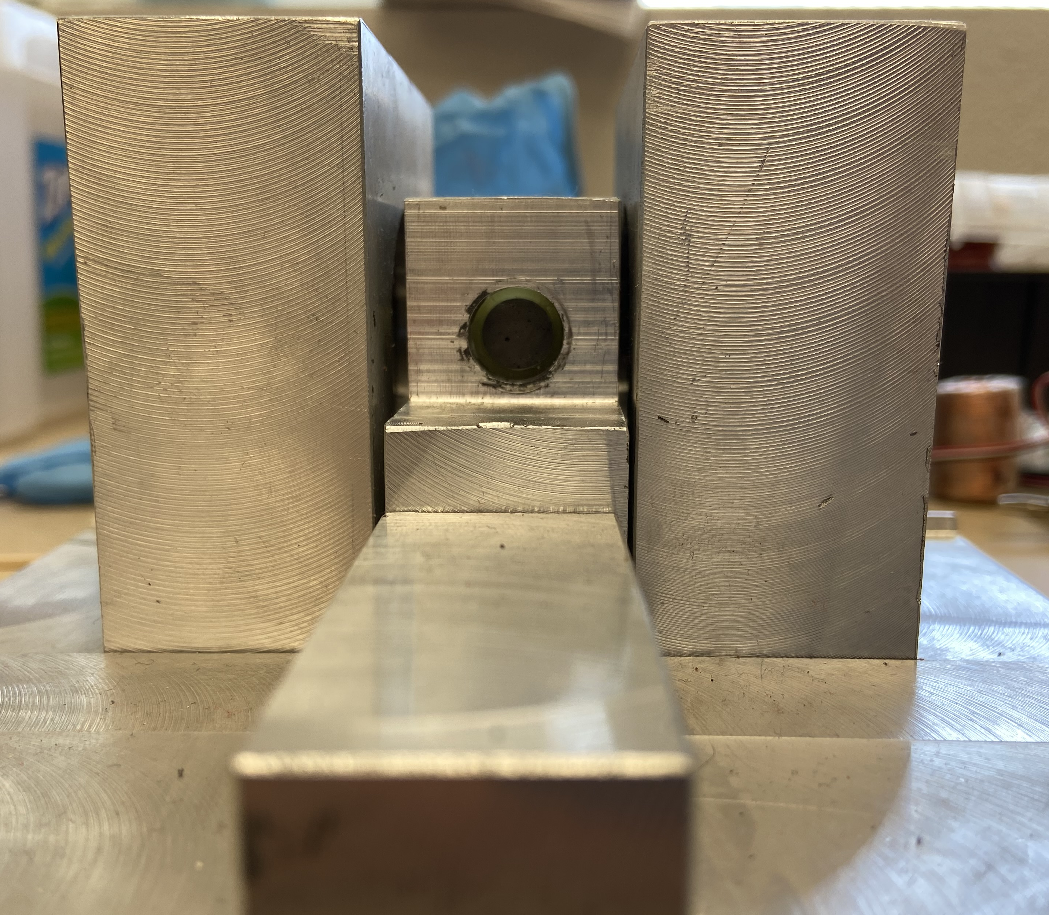
Samples Preparation
Spacer
Electric motor
Mold casting process
Samples with MSMA rods
60% iron particles volume fraction mixed with
a silicone polymer
3 mm by 3mm by 20 mm MSMA rod added
after silicone was poured in the mold
Samples made with MSMA Particles
30% MSMA and 60% iron particles volume
fractions mixed with a slime
30% MSMA and 60% iron particles volume
fractions mixed with a silicone polymer
All samples were cured in a mold under rotating magnetic field
Gear box
Sample
Permanent magnet
Fabrication device
Permanent magnet
Spacer
Permanent magnet
Sample
Notes:
Gear box = speed reducer
Consistent and constant rotation during curing

Slide 6
Samples Characterization
The best MAC composition consists of 60% iron particles and a 3 mm by 3mm by 20 mm MSMA rod
Evaluated the magnetic permeability of MAC samples (made with different iron particles volume fractions)
Evaluated the compliance of the samples
Evaluated the actuation strain of the samples
Magnetic Field
Electromagnetic Coil
Placed the MAC inside the coil
Applied currents of up to 2.0A to the coil
Measured magnetic field using a Gauss Meter
Strain
Measured the actuation strain of the MAC
MAC sample
Coil
Electro-magnet
MAC sample

Slide 7
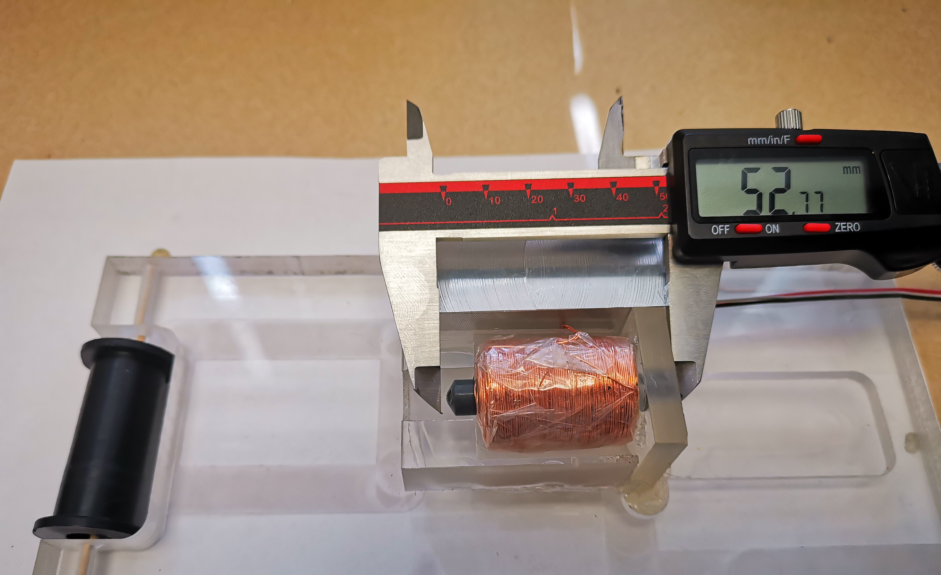
Results
1.82% strain corresponding to a 0.96mm deformation when a 2.5A current was passed through the coil
2.61% strain when an electromagnet generated a 0.42T field
0.96 mm

Slide 8
Conclusions
Project Goal:
Design and manufacture a highly compliant MAC
Methods:
Identified the composition that yields a highly magnetic permeable MAC
Established the best MAC manufacturing procedure
Characterized the MAC’s actuation performance
Adopted MAC Composition
60% volume fraction iron particles, MSMA rod, and silicon matrix
MAC performance
1.86% strain corresponding to a 0.96mm axial deformation
2.61% strain corresponding to a 0.42T magnetic field
Notes:
MAC actuates at lower currents with Iron

Slide 9
Future Work
Explore other matrix materials, including a more compliant magneto-elastic silicone made of iron nanoparticles suspended in polydimethylsiloxane.
Notes:
This magneto-elastic silicone was identified in the literature at the tail end of the project and has promising potential for our application.

Slide 10
Acknowledgements
Dr. Constantin Ciocanel, Ph.D, Mentor
Glen D’Silva, Ph.D Student
Paloma Davidson, NAU/NASA Space Grant Coordinator

Slide 11
Thank You

